Slide 1
Lenet Accelerator Final Presentation
第七組
翁啟文、賴柏光、羅允辰

Slide 2
Outline
Recap
P&R result
Post-layout simulation

Slide 3
Recap

Slide 4
Basic Workflow(HW5)
SRAM B0-B8
SRAM E
FC2
SRAM A0-A8
CONV1
FC1
SRAM F
Optimization:
Reduce area (CONV1+CONV2 & FC1+FC2)
Split pipeline (CONV & FC)
Pre-sim & gate-level sim result:
cycle count: 20770
cycle period: 4 ns
area: 77292.340211 um²
CONV2
SRAM_CONV
SRAM_FC
Origin
Overlap

Slide 5
P&R result

Slide 6
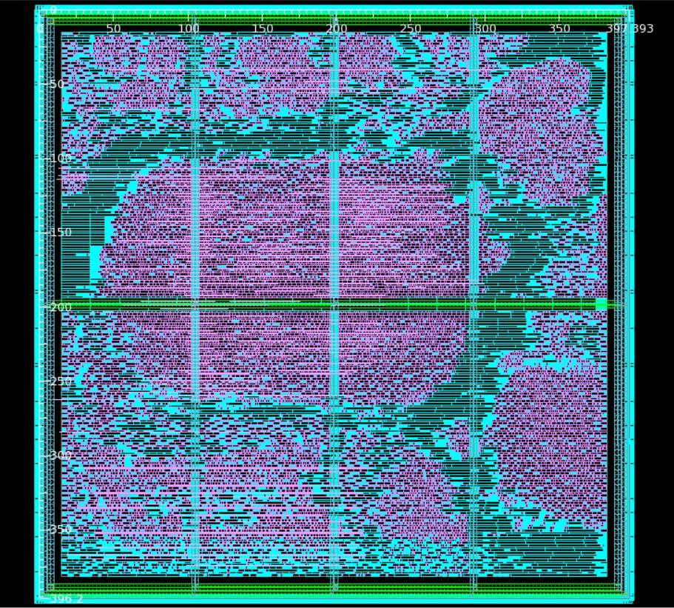
P&R Layout
CONV_control
FC_control
Core area:
397.393 * 396.200 = 157447.1066 um²
Core area: 88755.872684 um²
Utility: 56.37%
Quantize
CONV + FC
CONV_multiple_compare
FC_multiple_accumlator
CONV_datareg

Slide 7
P&R timing and power
Timing:
P&R clock period: 4.2ns (less than 1.1* Synthesis clock period = 4.4ns)
Power consumption (from ICC analysis):
1st : combinational logic circuit: 46%
2nd: register: 42%
3rd: clock: 12%
 |  | ICC analysis | Prime Time analysis
Dynamic Power | Internal | 3.4918 mW (54.45%) | 2.634 mW (47.13%)
 | Switching | 1.5274 mW (23.82%) | 1.548 mW (27.70%)
Leakage Power |  | 1.3933 mW (21.73%) | 1.406 mW (25.17%)
Total Power |  | 6.4125 mW | 5.589 mW

Slide 8
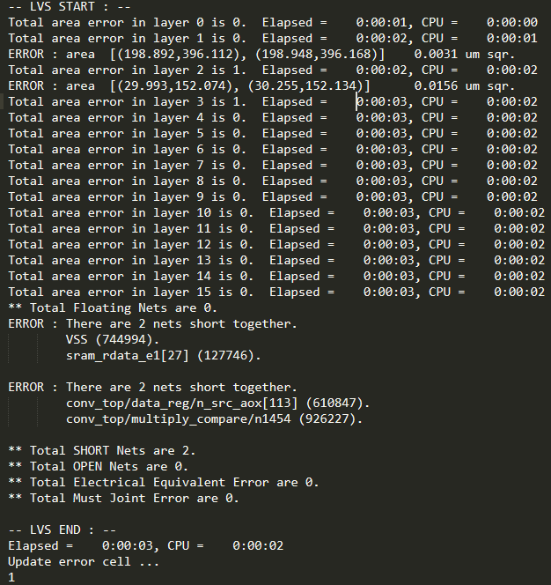
DRC and LVS verification
Pass DRC verification
There are 2 errors in LVS verification
Two short nets are detected.
However, our post layout simulation
have passed (strange…).

Slide 9
Post-layout simulation

Slide 10
Result
cycle period in testbench: 10ns
SRAM read data delay: 0.3*cycle period
I/O external delay: 2ns (half of synthesis clock period)
Total cycle counts:
CONV+FC: 19736 + 20770 = 40506
In reality, only 20770 cycles required due to our pipeline design

Slide 11
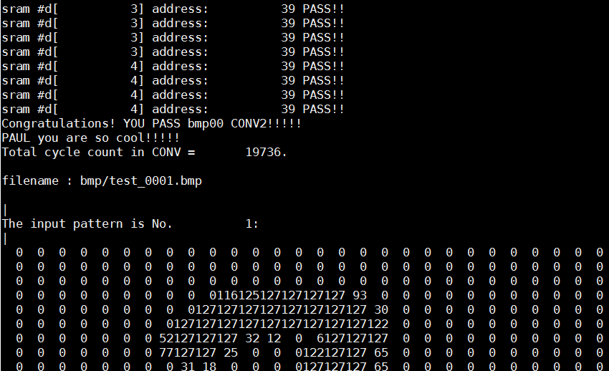
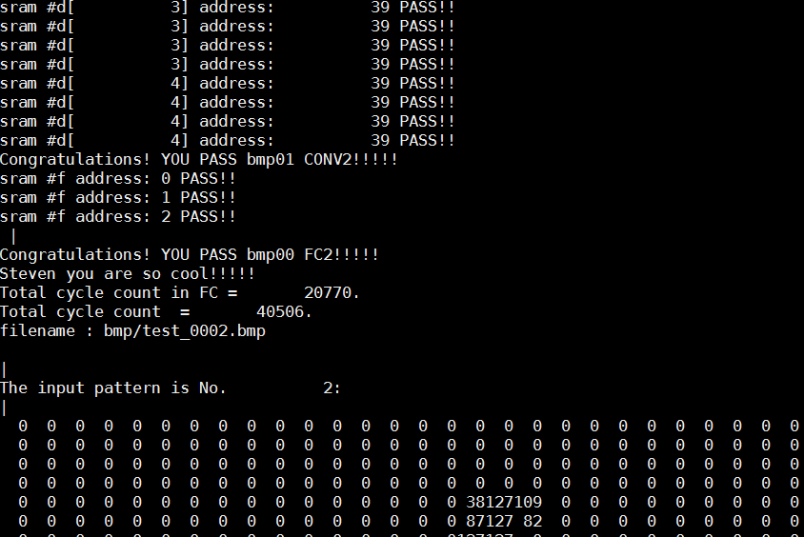
Snapshots

